Slide 1
Week 3 & 4 Plan
Make the scaling constant for all graphs
Starting using large ARC data
Goal: increase the population that utilize public transit system (currently 2%)
Use it to evaluate current network design (on MARTA data)
Generate new O-D pairs to design
Use it for hub selection (explore new ML method to find potential hubs)
Analysis
Current network design
Hub selection
Case study
Specific region
Areas of improvement
Study robustness
Etc.

Slide 2
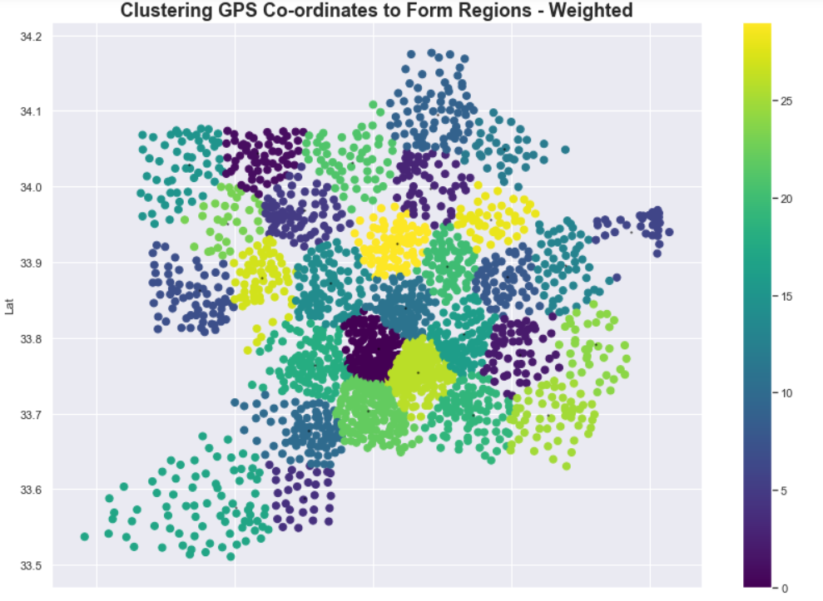
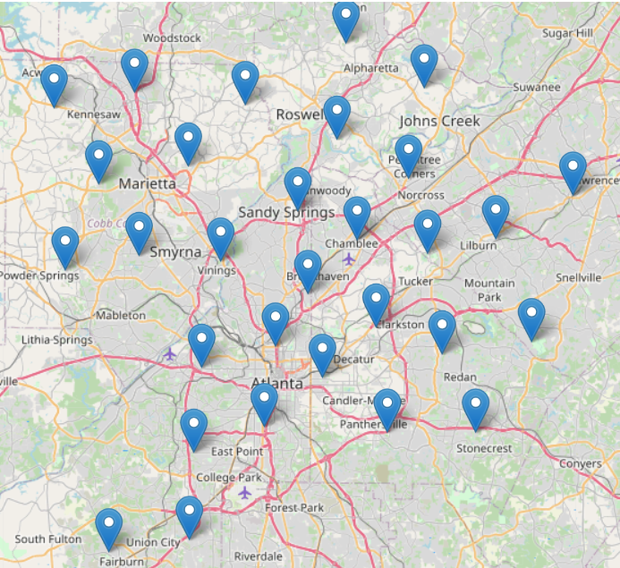
Week 4 Progress
Weighted K-Means for hub selection
Number: 30 clusters
Time block: 8:00-10:00 AM
ARC datapoints: 81127
Target: working population (filtered by tour purpose)
work_bluecollar
Work_whitecollar
Work_service
work_retailandfood
work_services
Currently working on generating new o-d pairs for the design network
Utilizing Anthony’s algorithm to combine o-d pairs based on radius
Want to generate less than 5000 clusters of o-d pairs to work with
Next step: generating ARC regional network designs & final network design

